Slide 1
BY K.A SAURI (CODE PLATEAU PROJECT 2)
TANZANIA TOURISM SECTOR

Slide 2
CONTEXT
Tanzania received a record 1.1 million international visitor arrivals in 2014, mostly from Europe, the US and Africa. Tanzania is the only country in the world which has allocated more than 25% of its total area for wildlife, national parks, and protected areas.There are 16 national parks in Tanzania, 28 game reserves, 44 game-controlled areas, two marine parks and one conservation area.

Slide 3
OBJECTIVE
The objective of this project is to explore and build a linear regression model that will predict the spending behaivior of tourists visiting Tanzania. The model can be used by different tour operators and the Tanzania Tourism Board to automatically help tourists across the world estimate their expenditure before visiting Tanzania.

Slide 4
DATA DESCRIPTION
Let’s explore our dataset to visualize interesting features

Slide 5
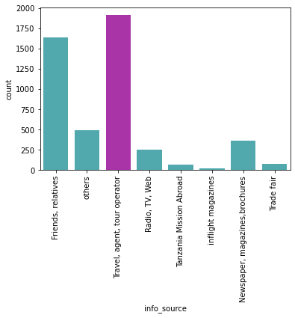
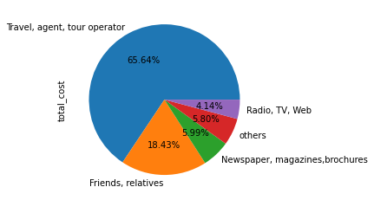
INFORMATION SOURCE OF TOUR DESTINATION
Travel agent and tour operator are the leading information source

Slide 6
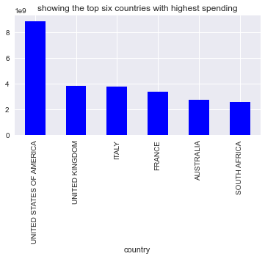
top 5 countries with the highest spending statistic
USA spend the most of all countries visiting Tazania

Slide 7
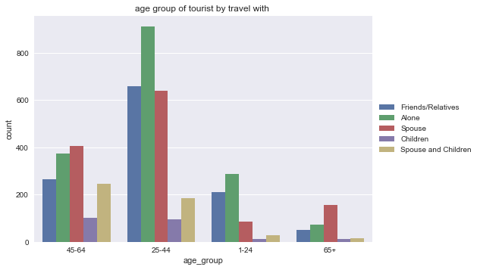
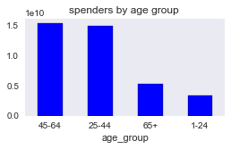
which age-group are the highest spenders and who are the over all highest spenders by travel with?
25 - 44 years travels the most especially with spouse but spend less than 45 -64

Slide 8
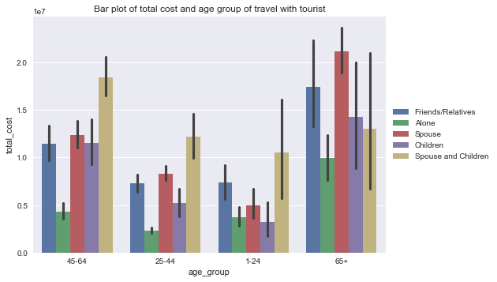
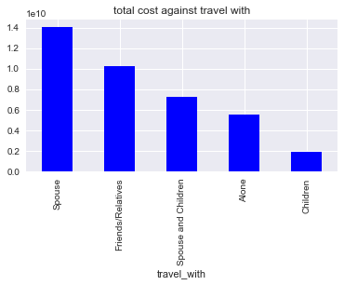
Indepth understanding of the total cost, travel with and age group of Tourist

Slide 9
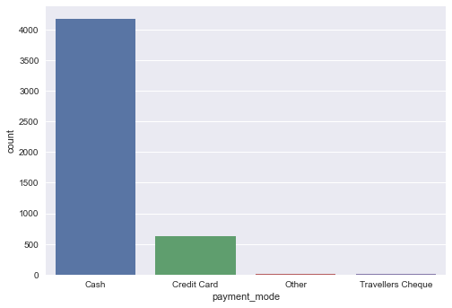
what is the most prefered payment mode by tourists?
Cash is the most preferred by tourist.

Slide 10
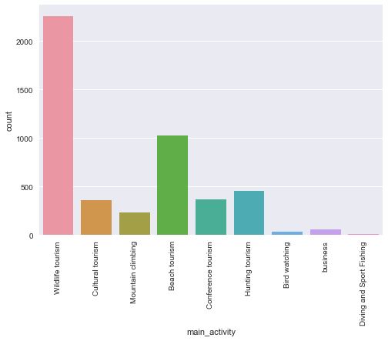
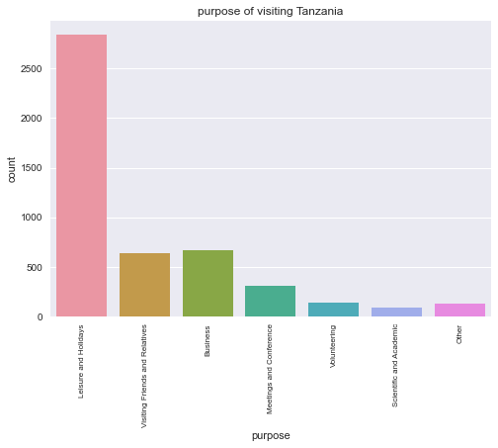
ACTIVITY AND PURPOSE
Activity and purpose of Tourist

Slide 11
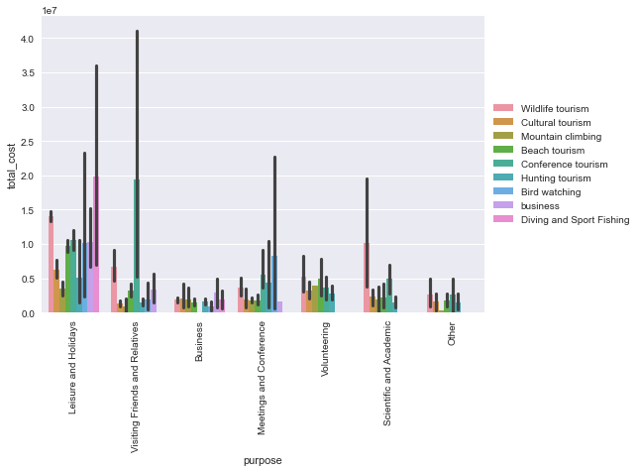
Aspects of tourism that are more profitable and in which it is worthwhile to invest in is diving and sport fishing where tourist spend more

Slide 12
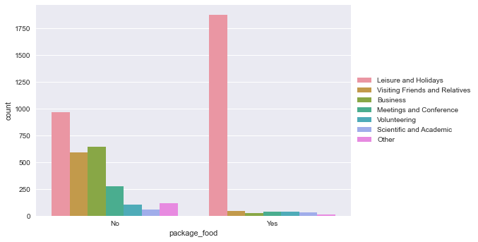
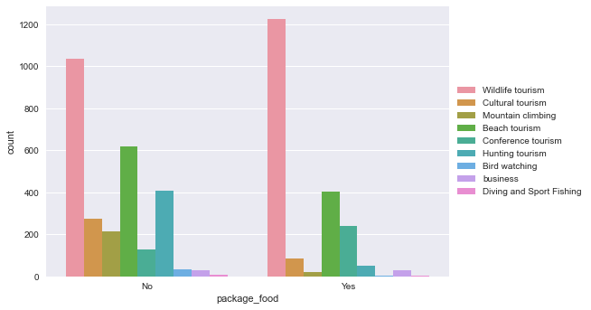
PACKAGE FOOD
Notes:
Package food consumption understanding

Slide 13
what is the average number of nights a toursits spends in Tanzania mainland and zanzibar?
An average number of eight night was spent by tourist in Tanzania mainland
An average number of 2 night was spent by tourist in Zanzibar

Slide 14
MODEL INSIGHT
Linear regression model was used for this study and it gave an r2 score of 0.279. linear regression model perform poorly and not a good model to evaluate the dataset. we recommend therefore, that other models show be used to model the dataset for high performance.

Slide 15
RECOMMENDATION
Study should be done exploring other models or regressors.

Slide 16
Thank you

